Slide 1
Variables in java
Department of Data Science
Faculty of information technology, Mutah university

Slide 2
Variables
Variables in java are like other programming languages: containers to store values
There are various types of variables in java
String - stores text, such as "Hello". String values are surrounded by double quotes
int - stores integers (whole numbers), without decimals, such as 123 or -123.
integer values range from -2147483648 to 2147483647
float - stores floating point numbers, with decimals, such as 19.99 or -19.99
char - stores single characters, such as 'a' or 'B'. Char values are surrounded by single quotes
boolean - stores values with two states: true or false

Slide 3
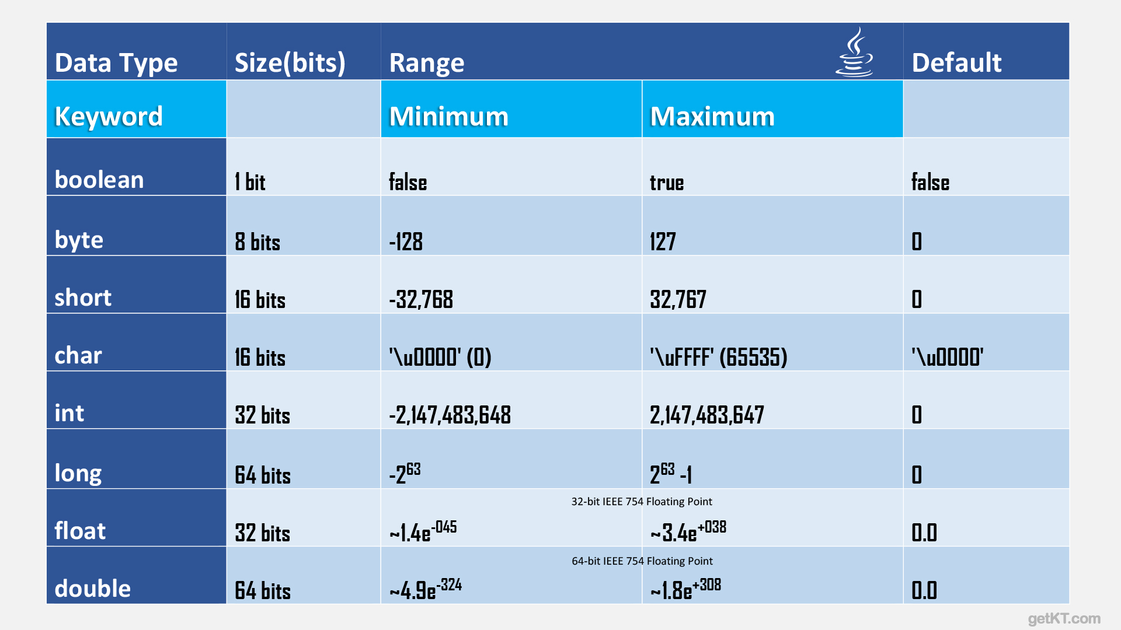
Summary of Data types

Slide 4
Syntax
DataType variableName = value;
The above statement is called variable declaration
Example:
The variable name is age, and it contains the value 30
When you execute this code, the result 30 will appear in the console
Replace int age = 30; with String name = "Ahmad"; and check the results
What else should be changed?
You can use byte instead of int when you are sure that the value is in the range -128 and 127:
variables can be reassigned during the execution of the application
public class Main { public static void main(String[] args) { int age = 30; System.out.println(age); } }

Slide 5
Multi variables
You can declare as many variables as you want (need), of any type you need.
public class Main { public static void main(String[] args) { int x = 20; int y = 60; String rate = "High"; double salary = 355.30; float price = 3.5f; System.out.println("my rate is " + rate); System.out.println("new location is " + (x + y) + " where X = " + x + " and y = "+ y); System.out.println("my salary is " + salary); System.out.println("the price is " + price); } }

Slide 6
Identifiers
All variables in java must have names, these names are called identifiers
The identifiers should be representative
Identifiers are case sensitive in java
Age and age are different variables might or might not hold the same values
If you have many variables with the same data type, you can write the data type once, and the variables separated with commas, as follows:
int num = 20, val = 1000;
int Age = 33; // good and representative identifier int a = 33; // Will work but bad for large applications

Slide 7
Rules for writing identifiers
Can contain letters, digits, underscores, and dollar signs
Must begin with a letter
Should start with a lowercase letter and it cannot contain whitespace
Can also begin with $ and _ (but we will not use it in this course)
Names are case sensitive ("Var" and "var" are different variables)
Reserved words (like Java keywords, such as int, float, class or boolean) cannot be used as names

Slide 8
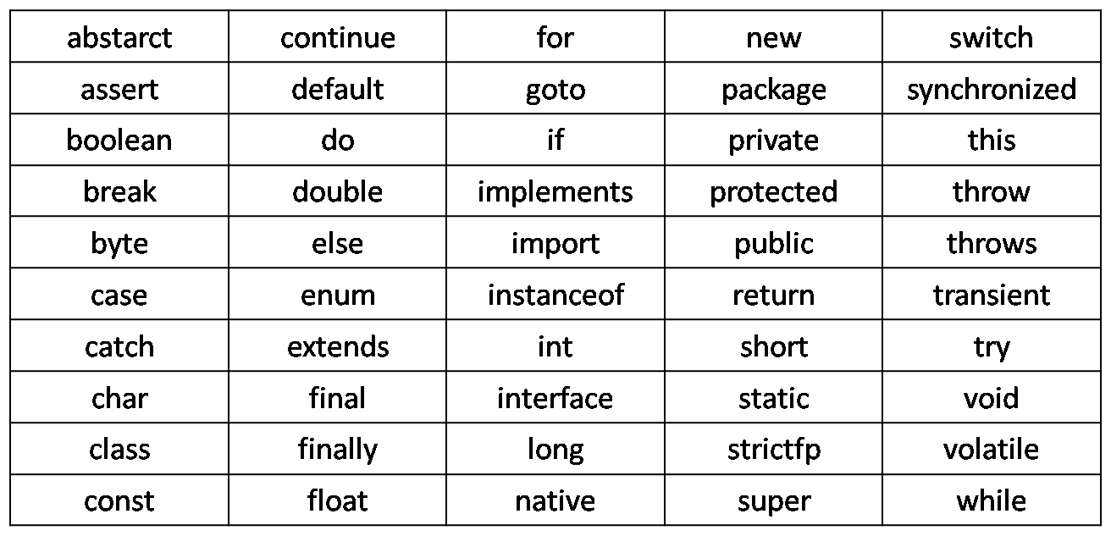
Keywords

Slide 9
Logical variables
Logical variables can hold one out of two possible values: true or false
Logical variables are very useful in many cases such as conditional statements and loops
Later in this course
public class Main { public static void main(String[] args) { boolean on = true; Boolean off = false; System.out.println(on); System.out.println(off); } }
Output:
true
false

Slide 10
Data Type Casting
public class Main { public static void main(String[] args) { int number = 9; double newNumber = number; // int to double System.out.println(number); // Outputs 9 System.out.println(newNumber); // Outputs 9.0 } }
In java you can convert from one datatype to another, as needed.
There are two type of casting
Widening casting: done automatically when passing a smaller size type to a larger size type
Narrowing Casting: Done manually to convert higher data type to lower data type
Try to convert int 127 and 128 from int to byte
public class Main { public static void main(String[] args) { double number = 9.78d; int numberInt = (int) number; double to int System.out.println(number); // Outputs 9.78 System.out.println(numberInt); // Outputs 9 } }

Slide 11
final keyword
public class Main { public static void main(String[] args) { int number = 50; System.out.println(number); number = 1; System.out.println(number); } }
As mentioned earlier: the variables can be reassigned during the application
Sometimes for some reasons you might the value to be final, cannot be changed
Assure that the value is not modifiable.
LATER: Can be used with methods as well
public class Main { public static void main(String[] args) { final int number = 50; System.out.println(number); number = 1; System.out.println(number); } }
java: cannot assign a value to final variable number

Slide 12
Operators

Slide 13
Arithmetic Operators
Operator | Name | Description | Example
+ | Addition | Adds together two values | x + y
- | Subtraction | Subtracts one value from another | x - y
* | Multiplication | Multiplies two values | x * y
/ | Division | Divides one value by another | x / y
% | Modulus | Returns the division remainder | x % y
++ | Increment | Increases the value of a variable by 1 | ++x x++
-- | Decrement | Decreases the value of a variable by 1 | --x x--

Slide 14
Assignment operators
Operator | Example | Same As
= | x = 10 | x = 10
+= | x += 5 | x = x + 5
-= | x -= 5 | x = x - 5
*= | x *= 5 | x = x * 5
/= | x /= 5 | x = x / 5
%= | x %= 5 | x = x % 5

Slide 15
Comparison Operators
Operator | Name | Example
== | Equal to | x == y
!= | Not equal | x != y
> | Greater than | x > y
< | Less than | x < y
>= | Greater than or equal to | x >= y
<= | Less than or equal to | x <= y

Slide 16
Logical Operators
Operator | Name | Description | Example
&& | Logical and | Returns true if both statements are true | x < 5 && x < 10
|| | Logical or | Returns true if one of the statements is true | x < 5 || x < 4
! | Logical not | Reverse the result, returns false if the result is true | !(x < 5 && x < 10)
you can use & instead of &&. However, using & the whole expression will be evaluated even if the first value is false
Example with OR |
exprA | exprB <-- this means evaluate exprA then evaluate exprB then do the |.
exprA || exprB <-- this means evaluate exprA and only if this is false then evaluate exprB and do the ||
6 < 5 & 6 < 10
in this example when we use & it will evaluate both 6 < 5 and 6 < 10.
We know that the and returns false if the first expression is false. Using && the program will find the 6 < 5 is false so it will not check the other expression, and it will return false directly

Slide 17
Priority of operations
in java some operations have more priority to be executed than other operations
Parenthesis () give priority to the expression inside them
Operators on the same level are executed from left to right
Operation
++x --x x++ x-- | Unary post increment
-x +x !x | Unary (plus, minus, not)
/ * % | Div, mul, mod
+ - | Addition subtraction
< <= > >= | Comparison
== != | Equality, not equality
& | Bitwise and
| | Bitwise or
= += -= /= *= %= | Assignment

Slide 18
Examples
Assume that you have the following variables
x = 5 and y = 9
what is the result of the following statements
y%x
x==y
x==y || y<10
x != y && x-3*2< 4
x != y && (x-3)*2< 4
(x + (x+y))+ (2-y) / 2

Slide 19

Exercises
int a = 4;
int b = 6;
int c = 8;
int d = 10;
result = a < b && c > d || !(c - d * b + a == -52)
int x = 10;
int y = 3;
double result = x * y + x / y – Math.pow(x, y) % 5
Math.pow(x, y) => $x^{y}$

Slide 20
Math package

Slide 21
Mathematical functions
The Java Math class has many methods that allows you to perform mathematical tasks on numbers.
The function we will address here are:
Math.max(a, b)
Math.min(a, b)
Math.sqrt(a)
Math.exp(a)
Math.pow(a, b)
Math.ceil(double a)
Math.round(double a)

Slide 22
max and min
public class Main { public static void main(String[] args) { int var1 = 5; int var2 = 10; System.out.println("The largest number is "+ Math.max(var1,var2)); System.out.println("The smallest number is "+ Math.min(var1,var2)); } }
The largest number is 10
The smallest number is 5

Slide 23
Sqrt, pow and exp
sqrt(value): returns the square root of the value passed to the method
pow(a, b): returns the result of the value a raised to the power b
exp(a): Returns Euler's number e ≈ 2.71828 raised to the power of a
public class Main { public static void main(String[] args) { int var1 = 5; int var2 = 10; System.out.println("The exp of " + var1 + " is "+ Math.exp(var1)); System.out.println("The sqrt of " + var2 + " is "+ Math.sqrt(var2)); System.out.println(var1 +" to the power 2 is "+ Math.pow(var1,2)); } }
The exp of 5 is 148.4131591025766
The sqrt of 10 is 3.1622776601683795
5 to the power 2 is 25.0

Slide 24
Ceil and round
Ceil returns the closest integer larger than or equal to the passed argument
Math.ceil(5.1) = 6
Math.ceil(7.5) = 8
Math.ceil(-1.9) = -1
round returns the closest integer to the passed argument
Math.round(5.1) = 5
Math.round(7.5) = 8
Math.round(-1.9) = -2
Math.round(-1.5) = -1

Slide 25
Exercise
Write a java program to evaluate and print the result of the following expression, given that:
Result = x * (2 + y) / 2
Given that:
x = 5, y = 4.5
Round the value using the round function and print the result

